Slide 1

NBA Player Salary
IDS 702 : FINAL PROJECT
Junbo Guan
11/15/2020
Notes:
Work on the wording of the title . couldn’t find blonde hair color icon for caleb :(

Slide 2
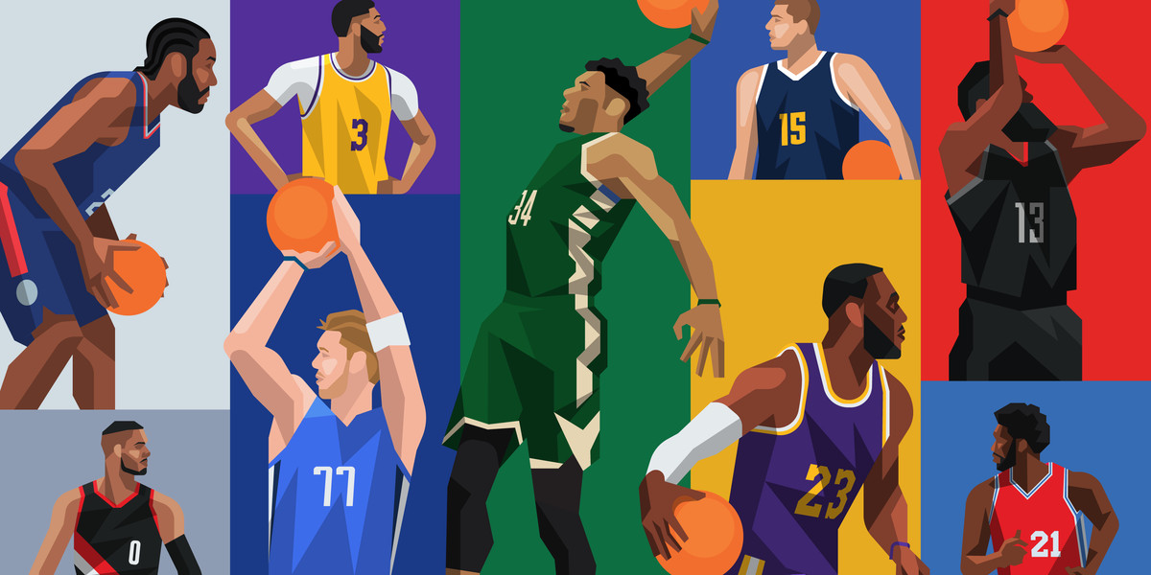
NBA Players from 1995 to 2017
introduction
Notes:
Thank you for your attention. If you have any questions, please feel free to ask us.

Slide 3
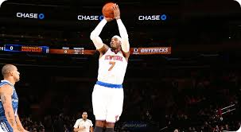
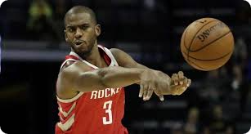



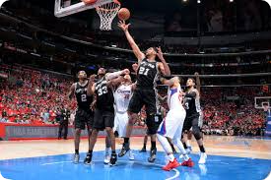
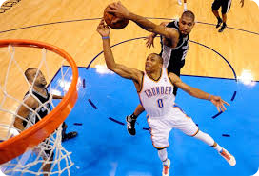


What statistic matters?
Introduction
Statistics
Point
Assist
Rebound
PER
Notes:
[Script]
The goal of this project was to identify groups of North Carolinians that were more likely to vote after being registered.
After aggregating data collected from the NCSBE, our dataset consisted of counties that contained multiple groups of people based on age, race, party, and sex.
Using these features, we created a hierarchical model to predict voter turnout. More specifically, we wanted to see how the likelihood of turnout changed by sex and if an association between sex and party existed with turnout.

Slide 4
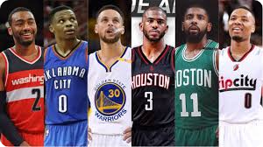
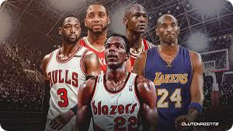
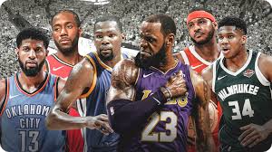
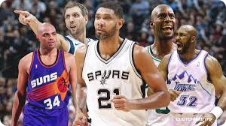
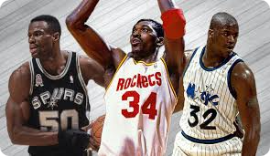
Which position?
Introduction
Positions
Point Guard
Shooting Guard
Small Forward
Power Forward
Center
Notes:
[Script]
The goal of this project was to identify groups of North Carolinians that were more likely to vote after being registered.
After aggregating data collected from the NCSBE, our dataset consisted of counties that contained multiple groups of people based on age, race, party, and sex.
Using these features, we created a hierarchical model to predict voter turnout. More specifically, we wanted to see how the likelihood of turnout changed by sex and if an association between sex and party existed with turnout.

Slide 5
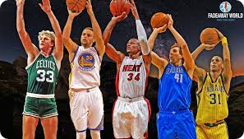
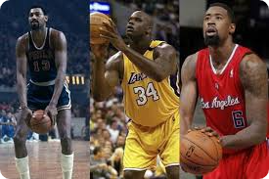
Three point Shooter?
Introduction
Three Points
Three Point Shooter
Non-Three Point Shooter
Notes:
[Script]
The goal of this project was to identify groups of North Carolinians that were more likely to vote after being registered.
After aggregating data collected from the NCSBE, our dataset consisted of counties that contained multiple groups of people based on age, race, party, and sex.
Using these features, we created a hierarchical model to predict voter turnout. More specifically, we wanted to see how the likelihood of turnout changed by sex and if an association between sex and party existed with turnout.

Slide 6
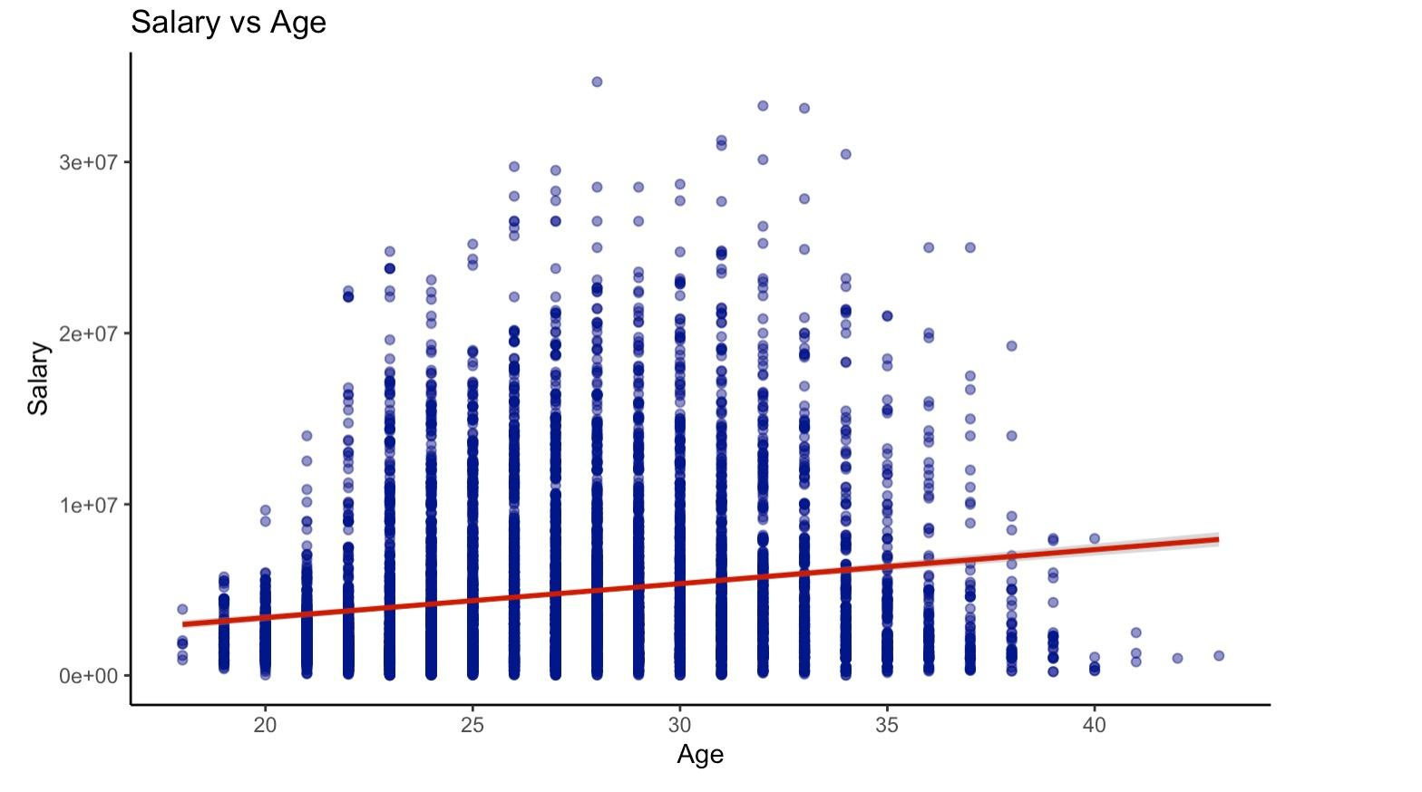
Relationship between Age and Salary
Exploratory Data Analysis
Party

Slide 7
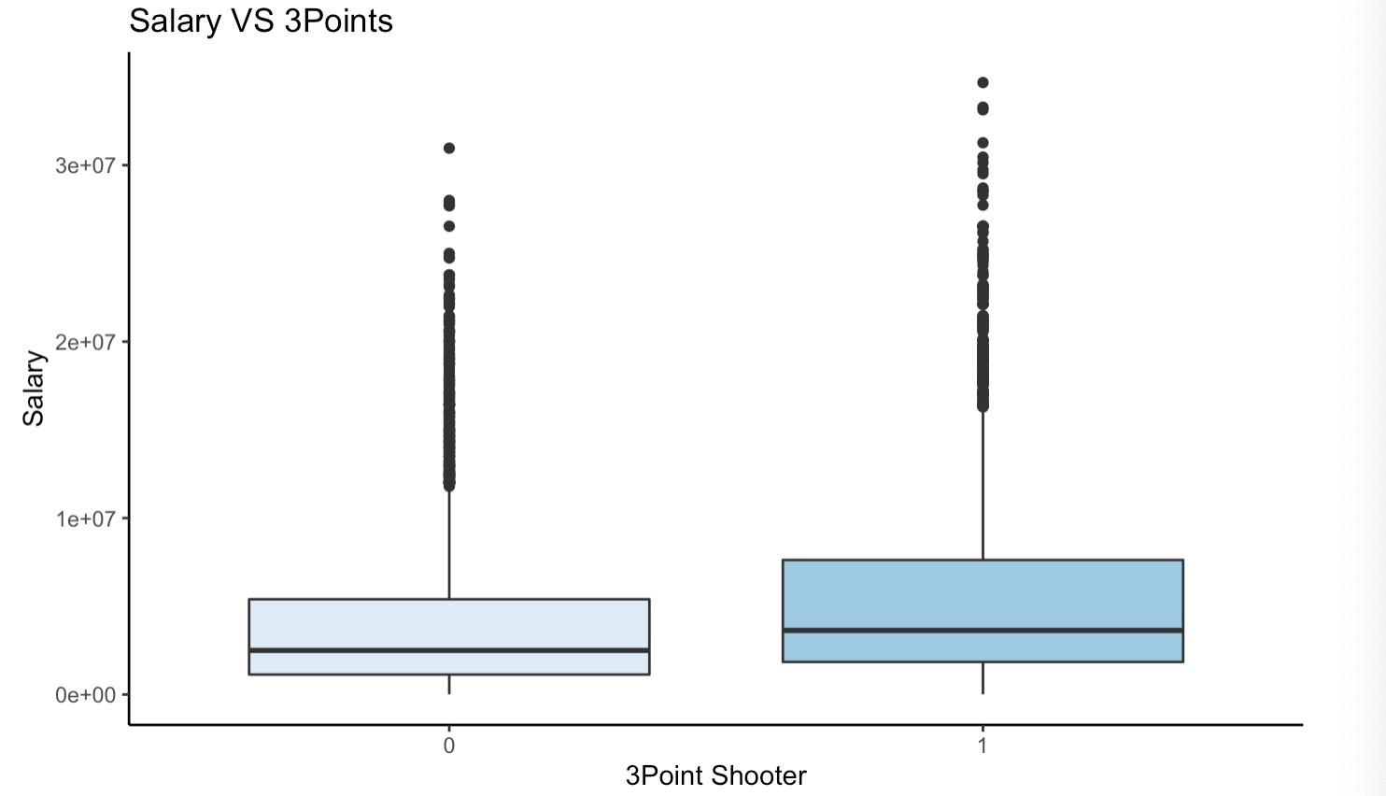
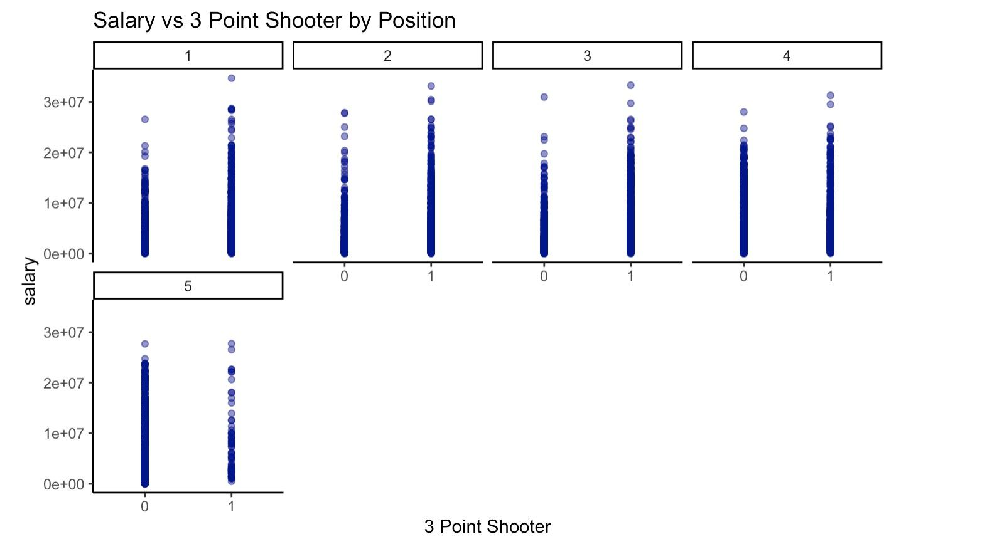
Relationship between Salary and 3-Points by Position
Exploratory Data Analysis
Turnout

Slide 8
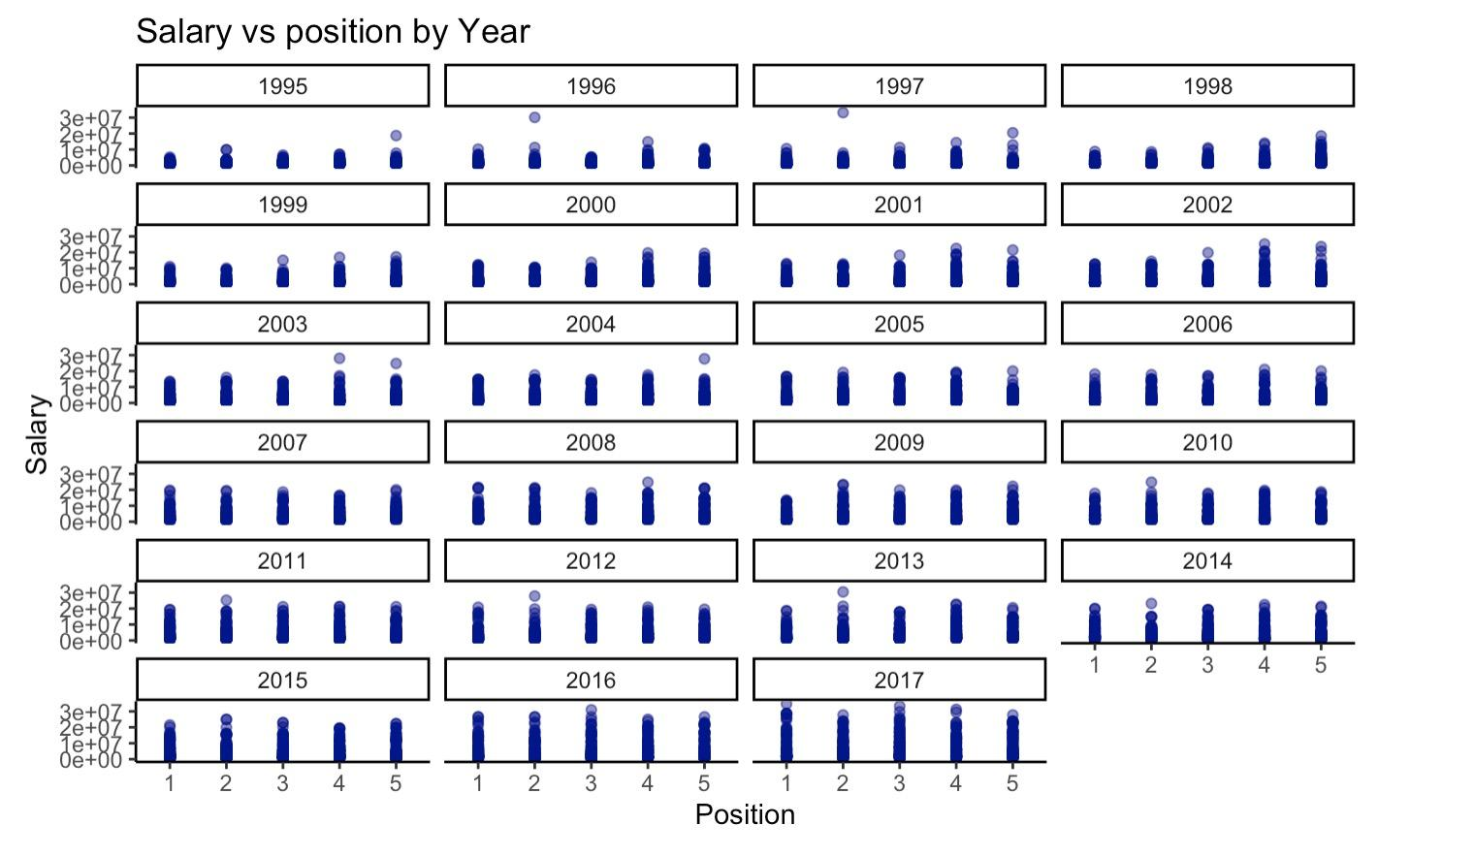
Relationship between Position and Salary by Year
Exploratory Data Analysis

Slide 9
Regular Statistics Model features
Salary ~ Pos + Agec + Agec2 + PPGc + Seasonc + RPGc + PFPGc + APGc + BPGc + GPc + GSc + FTPGc
Salary
Age
Points
Fouls
…...
= Significant

Slide 10
Advanced Statictics Model features
Salary ~ Pos + Agec + Agec2 + PERc + Seasonc + USGc + WSc + WS48c + BPMc + STLc + TSc + TOVc + FTrc + Pos:Seasonc
Salary
WS
PER
USG
Pos*Season
= Significant
= Significant

Slide 11
Future Work
Try to find out the casual effect of whether a player can shoot 3 pointer
Determine which teams are the best and worst at extracting value from their players

Slide 12
Thanks for Watching
Notes:
Thank you for your attention. If you have any questions, please feel free to ask us.

